Slide 1
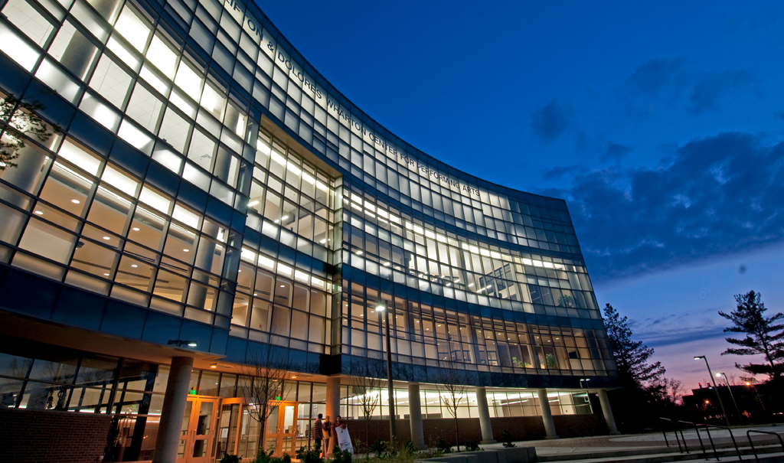

Living Case Study:
By: Brenna Green, Andrew Kelty, Laura Kring, Ryan Metcalf & Chris Mulligan

Slide 2
Topics to Be Covered:
Creating & Capturing Value
The Marketing Strategy & Planning Process
The Global Marketing Environment
Marketing Information & Research
Understanding Consumer Behavior
Creating Customer Satisfaction & Loyalty
Segmentation, Targeting & Positioning
Brand Management & Product Dimensions
Goods, Services & Nonprofit Marketing
Product Innovation & Management
Integrated Marketing Communications
Mass Communication: Advertising, Sales Promotions & Public Relations
Personal Selling & Sales Force Management
Pricing Objectives & Strategies
Conclusion

Slide 3
Creating and Capturing Value

Slide 4
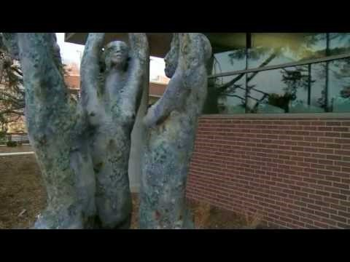
An Overview of Wharton Center

Slide 5
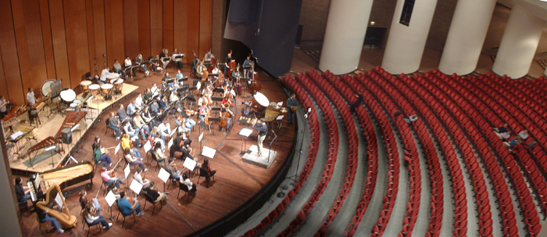
Mission Statement
“The mission of Wharton Center is to enrich the lives of Michigan residents and strengthen the value of the arts in everyday life by serving as a leading resource for renowned arts entertainment and education programs.”

Slide 6
2. The Marketing Strategy
& Planning Process

Slide 7
The Marketing Strategy & Planning Process
Core Values
Provide a diverse selection of leading performing arts shows
Promote and enrich the culture of Michigan State University campus life
Leading non-profit organization on campus
Business Definition
Wharton Center’s mission is to enrich the lives of Michigan residents and strengthen the value of the arts in everyday life by serving as a leading resource for renowned arts entertainment and arts education programs.

Slide 8
The Marketing Strategy & Planning Process
Strategic Direction
To be an industry leader in putting on top-class performing arts shows and entertainment
Core & Distinctive Competencies
Largest performing arts center in Michigan
Leading venue out of all the Big Ten universities
Non-profit
Student discounts
Dominant Strategy:
Wharton Center uses a differentiation approach. They distinguish themselves from competitors by offering world-renowned Broadway and performing arts programming to MSU, with far better quality than other university institutions. This differentiation depicts MSU as highly-valuing the arts on campus.

Slide 9
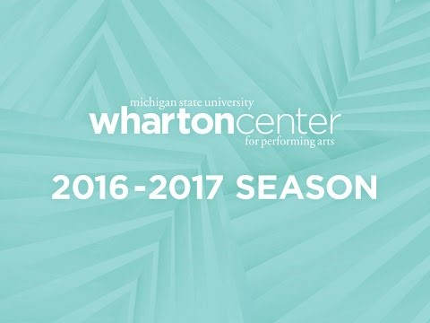
Strategy in Action:
Season Announcement

Slide 10
3. The Global Marketing
Environment

Slide 11
Internet Marketing Benefits
Access to More Customers
Customers can sell tickets 24/7 through the Wharton Center website, increasing sales and attendance
Use search engine ads so when customers search for shows, Wharton Center shows up
Increased Loyalty Through Customization
Season ticket holders can pick their seats to ensure the same experience at every show
Customer service to customize their experience
Reduced Supply-Chain Costs
Online marketing to to save on prints
Email tickets to customers to save on print and postage
Two-Way Communication
Customer service available 24/7 by chat and phone
Interaction through social media

Slide 12
4. Marketing Information
& Research

Slide 13
The Marketing Research Process
Problem Definition
Exploratory
Research
Design
Quantitative
Research
Design

Slide 14
Research Area for
Wharton Center
Step 1: Marketing Research Area
What prohibits a student from attending a show at Wharton Center?
Step 2: Problem Definition
Currently at Wharton Center’s performances, students comprise a disproportionate amount of the audiences considering the campus population.
Step 3: Exploratory Research Design
Focus groups and one-on-one interviews with students to gain insight on what prevents students from attending.
Step 4: Quantitative Research Design
Wharton Center could conduct online and in-person surveys to gain feedback on why students do not attend shows.

Slide 15
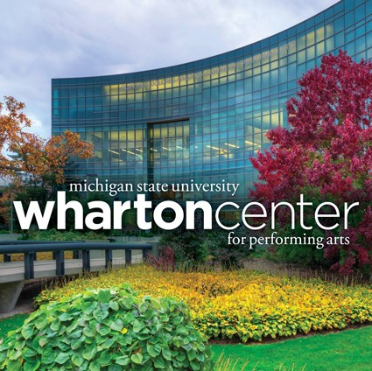
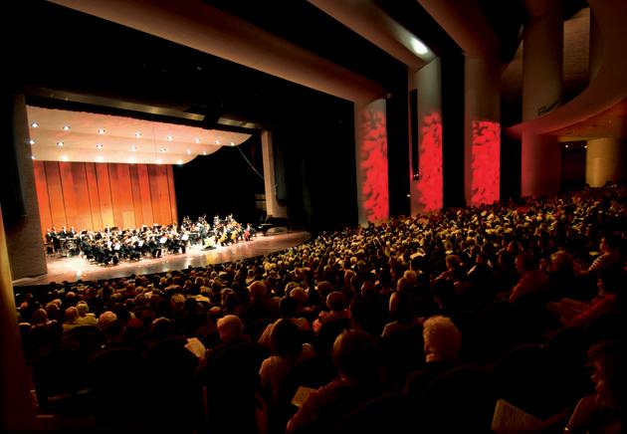
Marketing Information & Research
What influences students to come to the Wharton Center?
  Ticket Prices
  Show Times
  Show Genre
What prohibits a student from attending a show?
  Amount of Free Time
  Student Income
  Not Interested in Performing Arts

Slide 16
5. Understanding Consumer Behavior

Slide 17
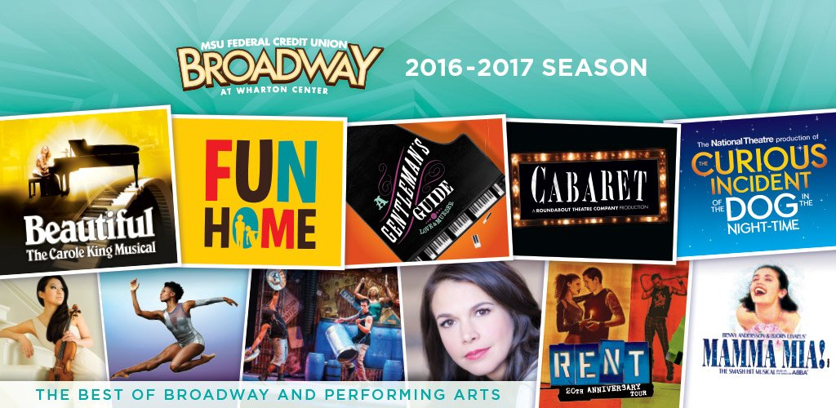
Understanding Consumer Behavior
Psychological Factors that influence consumer decisions:
Attitude
Attitudes students have for Broadway run the spectrum. Some are fanatical and have a positive attitude and others could care less.
Perception
Some students have been involved with theatre their entire lives and perceive theatre as enjoyment. Others do not perceive it as enjoyable because they are unfamiliar or it does not align with their interests.
To positively influence consumer behavior, Wharton Center could:
Provides shows for all ages and interests
Generate surveys to satisfy customer wants and interests

Slide 18
6. Creating Customer
Satisfaction & Loyalty

Slide 19
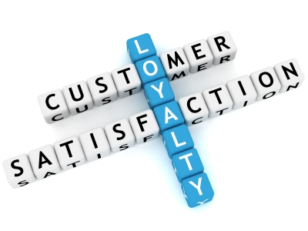
Creating Customer Satisfaction
Why are Customers Satisfied?
Create satisfaction by picking shows customers will enjoy and people will come back because they trust they will be entertained
The shows chosen are top-quality programs, making Wharton Center a leading performing arts institution
Customers are also satisfied by high-quality customer service and pristine facilities
Goal as a service organization is for customers to be satisfied with their experiences, resulting in customer loyalty as season tickets

Slide 20
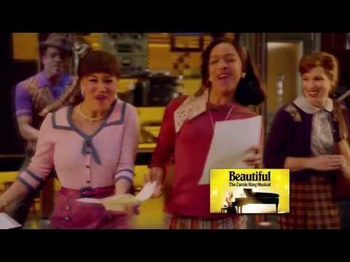
Loyalty in Action:
Season Ticket Subscription

Slide 21
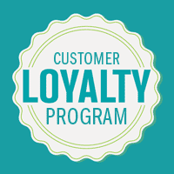
Creating Additional
Customer Loyalty
Create a loyalty program for Wharton Center:
The more shows you attend the more and better quality perks you will receive.
Use either the Wharton Center app to keep track, or a physical card if the app is not used by the customer.
Establish different levels of perks people can redeem at the center for various rewards.
Purchase tickets and experience a world-class performance with great customer service
Create customer loyalty through positive experience

Slide 22
7. Segmentation, Targeting
& Positioning

Slide 23
Segmentation Strategy:
Possible Variables & Categories
Demographic Segmentation
Variable: Family Life Cycle
Possible Categories:
College students
Young singles
Singles with children
Married couples
Married with young children
Empty Nesters
Matures
Demographic Segmentation
Variable: Gender
Possible Categories:
Male
Female
Behavioristic Segmentation
Variable: Loyalty
Possible Categories:
Never attended
Attends 1-3 shows per year
Attends 4-6 shows per year
Attends 7+ shows per year
Season ticket holder
Behavioristic Segmentation
Variable: Media & Shopping Habits
Possible Categories:
Purchase with app
Purchase with email
Purchase through website
Purchase through mailings
Purchase from box office

Slide 24


Differentiated Marketing Strategy
Differs their programming to appeal to as many demographics as possible
  ActOne Series for children and families
  NextGen for young business professionals
  Student ticket prices for MSU Students
  World View Lecture Series for MSU academic community
Programming strives to appeal to all cultures and ethnicities to make performing arts inclusive of all audiences

Slide 25
Positioning Map
High Quality
Two attributes:
Focus on affordability and quality of programming as these are the two characteristics audiences typically use to compare theatres.
Ideal Position
Current Position
Low Prices
High Prices
Low Quality

Slide 26
8. Brand Management &
Product Decisions

Slide 27

Brand Equity
Quality
Known for quality shows and concerts; often brings first national runs of Broadway productions and other prominent acts
Awareness
Lansing natives are very aware since it has served as a community staple; students tend to be less aware and attend shows less frequently
Associations
Broadway
Michigan State University
Local arts organizations

Slide 28

Brand Strategy
Greater Emphasis on Show Branding
  Wharton Center’s branding is more highly emphasized on its productions. For example, patrons are more familiar with the green and black logo associated with Wicked than Wharton Center’s logo.
Improve Branding: Joint Marketing Plan
  Wharton Center can partner with MSU Athletics to create and market an integrated ticketing app to allow students to buy and sell entertainment tickets in one place for the university. The app would increase brand awareness and, once students attend a performance, have them associate high brand quality with Wharton Center.

Slide 29
9. Goods, Services &
Nonprofit Marketing

Slide 30
Goods and Services
Continuum of Goods and Services
Pure Goods
Merchandise from Wharton Gifts
Goods With Services
Concessions
Half Goods Half Services
Box Office
Donor Lounge
Services with Goods
Parking
Pure Services
Shows
Wheelchair Service

Slide 31


Customer Evaluation
Experience Qualities
Shows are the experience
Patrons cannot judge the quality of a performance until after viewing
After seeing the show, the consumer then forms an opinion and can share it with others via different forms of communication (i.e. social media, review blogs, in person, etc.)

Slide 32
10. Product Innovation
& Management

Slide 33



Product Development
Wharton Center brings in a variety of shows each season to appeal to their loyal season ticket holders and new patrons alike. Their products include:
Comedy
Broadway
Music Groups/Concerts
The organization constantly strives to improve their season line-up over the previous season, and often select shows to target an underrepresented demographic.
Wharton Center’s Recent Innovations:
Continuous - Closed Captioning & Assisted Listening Devices
Dynamically Continuous - Sensory Friendly Performances
Discontinuous - Addition of digital ticket sales to print tickets

Slide 34
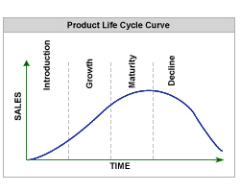
Product Life Cycle
Growth
Sensory Performances
Newly introduced with the first Broadway SFP expected in 2017/2018 season
Maturity
Broadway Shows
Consistently sold-out with more people wanting to view the shows than tickets available
Decline
Orchestral Performances
Younger audience is not as interested in these types of performances; low attendance

Slide 35
11. Integrated Marketing Communications

Slide 36
Integrated Marketing
Communication Objectives
Objectives
Advertise in an effort to communicate information about the different shows and performances to the customers
Effectively communicating the large variety of performances that the Wharton Center offers will help create demand across different audiences, demonstrate value, and show product uniqueness.
Having a simple and easy ticket purchasing process will make complete the sale and develop customer loyalty

Slide 37



Integrated Marketing Communication Campaign
Utilizing social media and digital advertising to communicate events, times, and other information can help market to the large number of students and young people that live in the greater Lansing area.
Being active on sites such as Twitter, Facebook, and instagram will help create brand awareness as well as communicate helpful information to customers who normally would not have seen or been aware of the performances.

Slide 38
12. Mass Communication:
Advertising, Sales Promotion &
Public Relations

Slide 39
Mass Communication Strategy
Sales Promotion
Student discounts
Season-ticket packages
Advertising
Focus on getting word out to select target markets
Public Relations
Dedicated PR team
Interviews with star performers
Low
High
Degree of Utilization

Slide 40

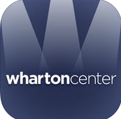
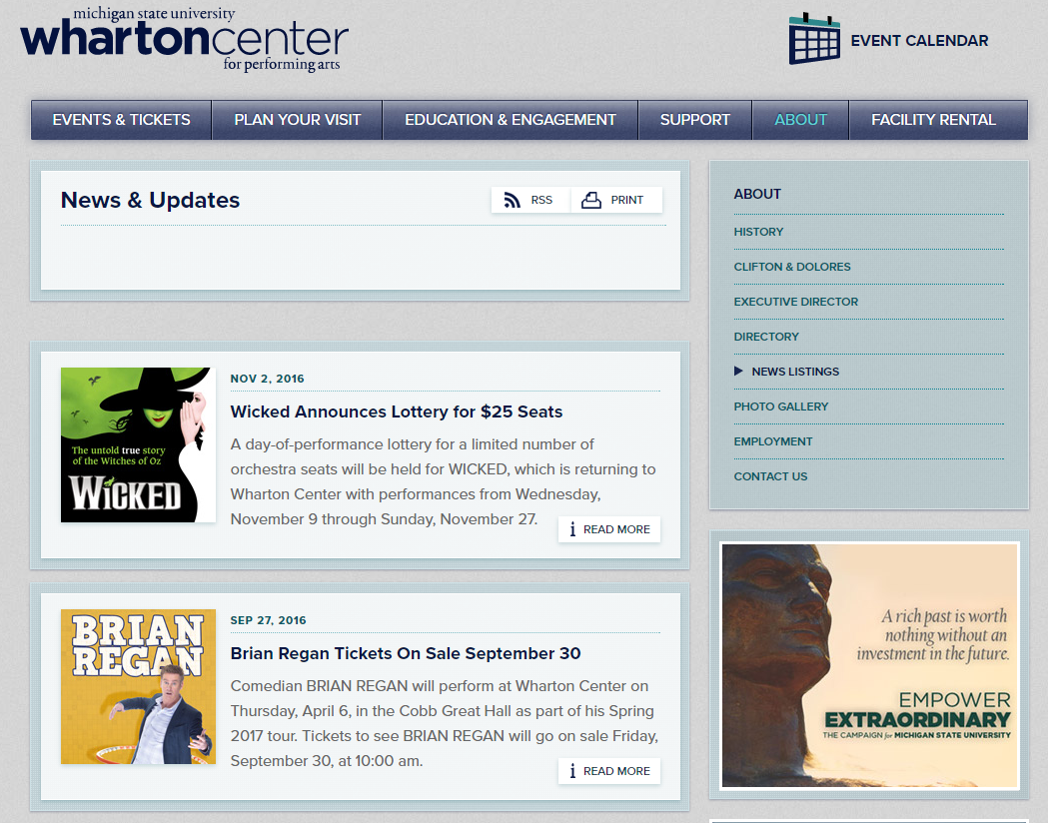


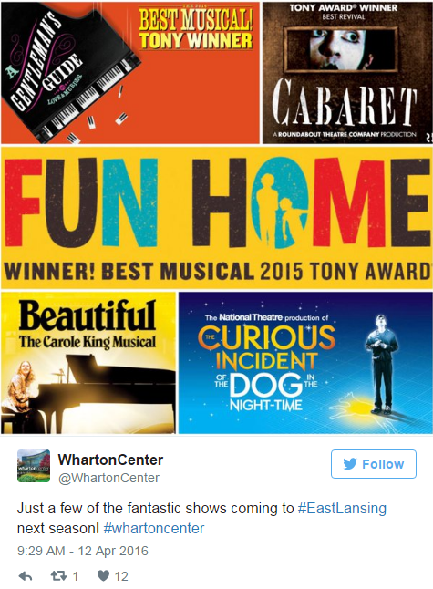
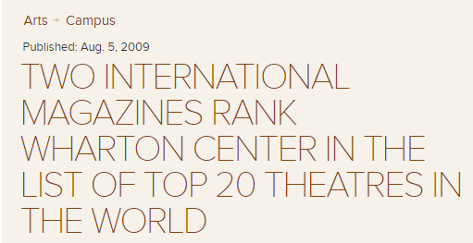

Media Outlets
Newspapers
Mobile App
Internet
Television
Outdoor Ads
Social Media
Magazines
Radio

Slide 41
13. Personal Selling & Sales
Force Management

Slide 42

Selling Strategies
Dominate Method: Direct Sales
Wharton Center utilizes direct sales through the campus telemarketing service, Greenline. This method is most compatible with its older clientele that predominantly communicates through telephone.
Their telemarketing services focus on targeting previous season ticket holders to renew subscriptions, businesses and churches for group sales, schools to attend children’s shows and donors for gifts.
Expand Sales Strategies
Use a field salesperson to make presentations to local schools and community groups about the advantages of attending a performance
Establish an on-campus digital ticket kiosk to increase ticket sales to students

Slide 43
14. Pricing Objectives & Strategies

Slide 44
Customer Value Propositions
Product Leadership
Wharton Center creates customer value by striving to bring in higher quality entertainment than other performing arts venues affiliated with universities. This includes debuting new works and presenting the first runs of many Broadway touring productions.
Customer Intimacy
Wharton Center also highly values customer service since the majority of their patrons are donors and they need their donations to survive
Positive customer experiences instill lasting positive impressions of the organization, resulting in customer loyalty

Slide 45
15. Conclusion

Slide 46
What We’ve Learned
Wharton Center is Michigan’s largest performing arts center and is the largest performing arts center affiliated with a university in the country. It brings in diverse programming with a variety of services in an effort to draw in diverse audiences representative of the Lansing community. The organization highly values customer service and survives on customer loyalty through season tickets. Overall, a major threat for the organization is their aging clientele and the resulting need to draw in a younger demographic. This can be accomplished through moving away from their focus on traditional advertising to digital advertising and social media in an effort to engage with students. In addition to advertising, the organization could establish an integrated ticketing app with the athletic department to make students more aware of the opportunities offered at Wharton Center.

Slide 47
Thank You

